Slide 1
Welcome to ‘Life after S6’ - a Firrhill guide for parents and carers’
Firrhill High School
August 23rd 2023

Slide 2
The road ahead….

Slide 3
Article 5 – Parental guidance
Governments must respect the rights and responsibilities of parents and carers to provide guidance and direction to their child as they grow up, so that they fully enjoy their rights. This must be done in a way that recognises the child’s increasing capacity to make their own choices.

Slide 4
Parental engagement @ Firrhill

Slide 5
Why parental engagement?
Policy landscape – parental engagement a key driver (SG NIF 2016, Achieving excellence and equity 2022)
“Primary determinant of higher pupil performance” (Topor et al, 2010)
“One of the best levers schools have for improvement in pupils' outcomes” (Goodall, 2017)
“ has most impact when it helps support learning at home, not being surveillers of homework “ (Fan and Williams, 2010)

Slide 6
Listen and ask questions
Let pupils teach you
Coach not mentor

Slide 7
Outcomes
To discuss pathways and options beyond S6
A look at the UCAS and College application route
Input from Edinburgh Napier University – what they’re looking for in a successful candidate
Input from LEAPS regarding Widening Participation
Apprenticeships
Q&A

Slide 8
What can you be doing just now?
Start a discussion with your child – what are they interested in?
Consider options, not just in terms of qualification level. Ask your child:
How do they like to learn?
Favourite subjects?
Do they want to do a mixture of things?
How long do they want to spend in the next stage?
Where do they want to be?

Slide 10
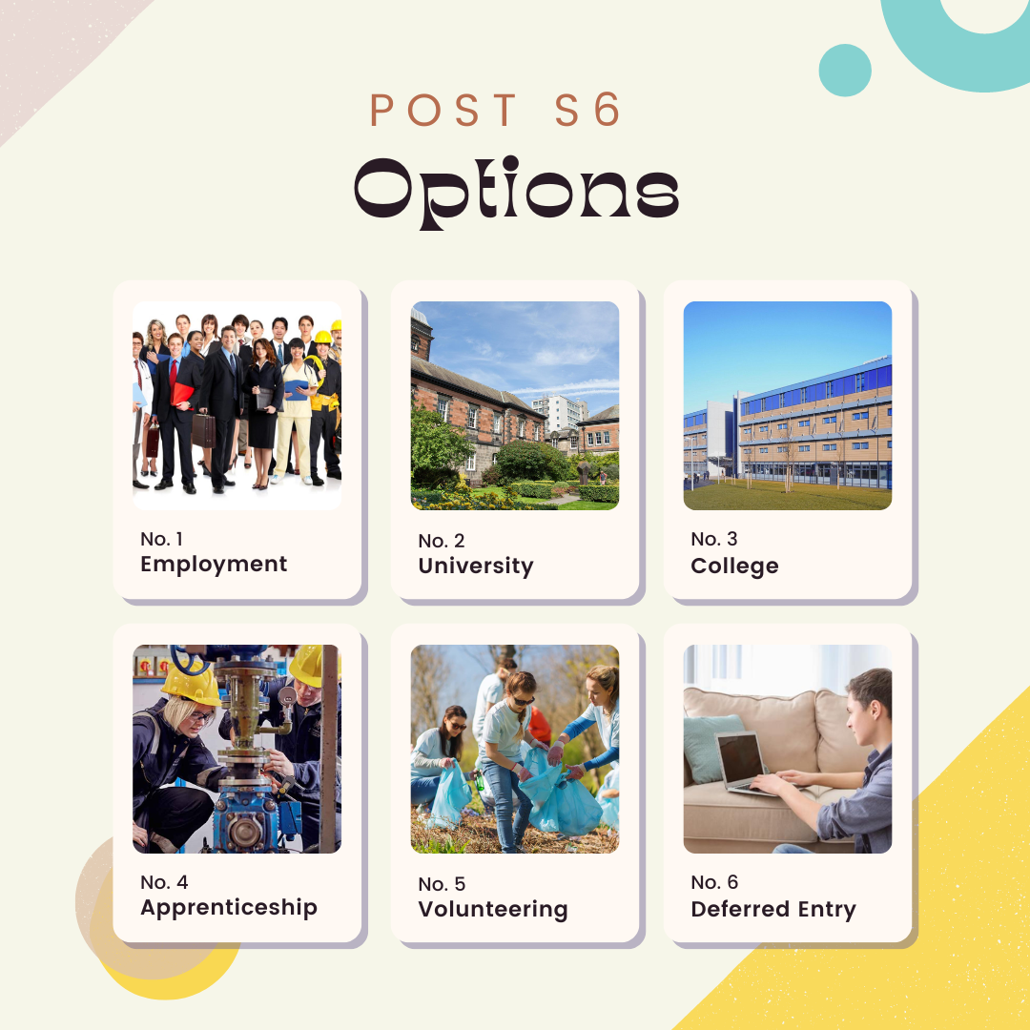

Slide 11
Further and Higher Education

Slide 12
Applying to University -
Pupils can make up to 5 choices. We recommend at least 3.
Dependent on S5, it would make sense to look at courses with different entry requirements. Do check any required subjects (although these are generally not as specific anymore)
Do look at each year of the course – different Universities may specialise in different areas (particularly in years 3-4)

Slide 13
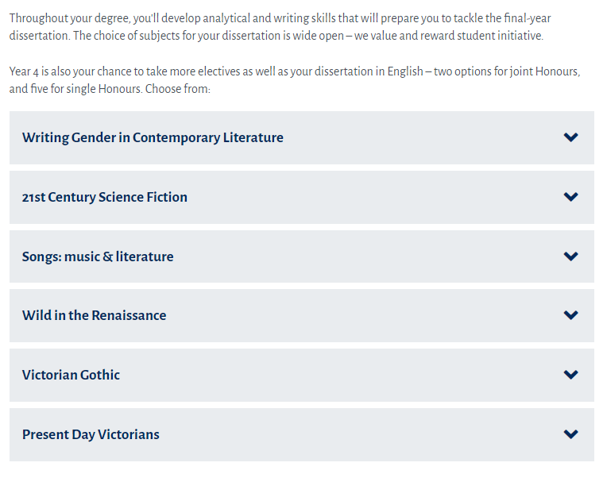
English at Strathclyde

Slide 14
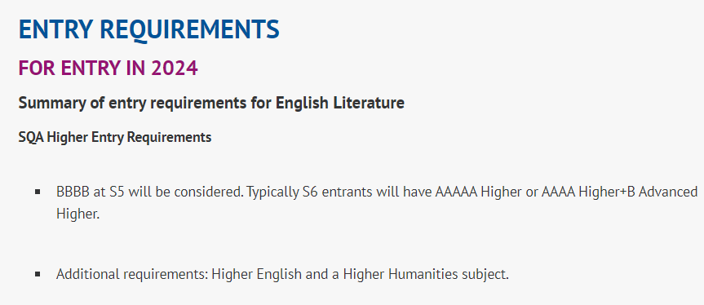
English at Glasgow University

Slide 15
Applying to University – Don’t
Pupils cannot apply to wildly diverse subject choices (e.g. Graphic Communication at Glasgow Caledonian and Paramedic Science at Robert Gordon University.) This is because they only get ONE personal statement
Don’t just focus on University ranking lists – consider all aspects of the establishment.
They should not apply to more than one course at the same University, or they may end up with this on their UCAS…

Slide 17
Timeline for Firrhill
Will be sent to Parents and Carers shortly.
Early Applicants (Oxford / Cambridge / Medicine / Vet Medicine / Dentistry) on a different timeline – have met with Mr. Hollis regularly.
Friday 23rd September – First completed draft of personal statement due to Pupil Support Leader.
Friday 7th October – All first drafts marked and returned to pupils. Pupils working on second draft.
Friday 13th October – Second drafts submitted to Pupil Support Leader.
Friday 27th October – All second drafts marked and returned to pupils. Pupils completing online process in PSE and continuing to work on drafts / meeting with Pupil Support Leader in PSE class.
At this point Pupil Support Leaders will be meeting with young people individually, and beginning to sign off / send off UCAS applications.
In school deadline for completion of UCAS statements is Friday 17th November

Slide 18
University
Nicola Kennedy, Senior Schools Outreach Officer

Slide 19
Deadlines for 2024 entry
UCAS Opens
September
Deadline for Music @
Royal Conservatoire
October 3
Deadline for Oxbridge,
Medicine, Vet Medicine
October 16
January 31
UCAS Deadline
January/February
College Courses open
Apply for Apprenticeships
All year but a lot around
January

Slide 20
Routes into University
University is more accessible than ever before with over 50 000 courses to choose from 130 universities in the UK
School
College
Apprenticeship
Full Time/Part Time
Articulation Routes
Access courses
Graduate Apprenticeships
There is no wrong path. Only what is best for the young person.

Slide 21
UCAS Application
Start by registering online. You will need your school buzzword. Once registered you will need to fill out the following sections;
Email address, funding options, address, support you need etc…
Your personal details
Additional Information
Won’t be used in application. For statistics
Course Choices
Not in order. You will need UCAS code
Education
All qualifications from S4-S6
Employment
Any paid part time jobs
Personal Statement
Written by young person
Teacher Reference
Written by teacher. Any additional info not in statement

Slide 22
Admissions
We look at all undergraduate applications. Some of the information we look for include:
Contextual Information
Qualifications & Subjects
Fee Status
Personal Statements

Slide 23
Contextual Admissions
Introduced to ensure fairness to all learners by taking full account of their circumstances
Applications are treated individually to assess whether the applicant has experienced disadvantage which may have affected their ability to achieve full potential
Introduction of minimum & standard/typical entry requirements
Greater need to know more about the applicant’s personal circumstances

Slide 24
Personal Statement
What is a personal statement?
An opportunity to demonstrate your passion and enthusiasm for the subject(s) you are applying for
An opportunity to sell yourself to universities about the skills and attributes you have which would make you a perfect candidate for that course
The FACTS!
You can only write one personal statement for all 5 universities
It has to be 47 lines, 4000 characters long
It MUST be relevant to what you are applying to
It can make the difference of whether you receive an offer or not
This year 40,250* Scottish young people applied to Scottish universities; the personal statement makes you stand out from everyone else applying.
*UCAS 2023 cycle applicant figures – January deadline
Notes:
Facts and figures updates?

Slide 25
Support
Although University is a jump from school, there is still lots of support available for your young people.
Academic Skills & Support
Wellbeing, Disability & Inclusion
Accommodation
Financial Support
Widening Participation
Career & Graduate Employment

Slide 26
Encouraging Career Exploration
Good resources & information for parents/carers on university:
UCAS (University application platform)
https://www.ucas.com/undergraduate/applying-university/ucas-undergraduate-advice-parents-and-guardians
My World of Work (for career exploration)
https://www.myworldofwork.co.uk/parents/topics
SAAS (student funding information)
https://www.saas.gov.uk/need-to-know/parent-and-carer-information
University or college virtual open days & information events
University & College websites

Slide 27
Contact us
Outreach@napier.ac.uk

Slide 28
College

Slide 29
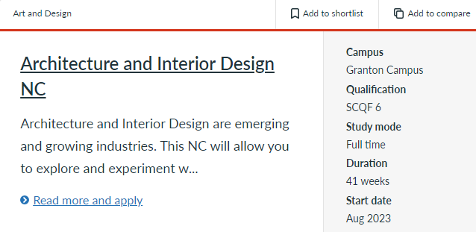
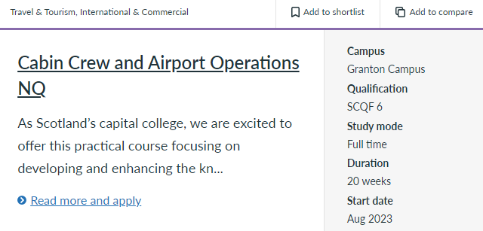
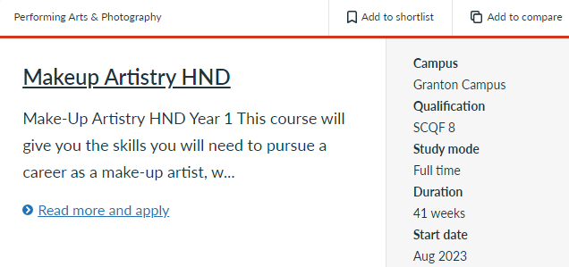

Slide 30
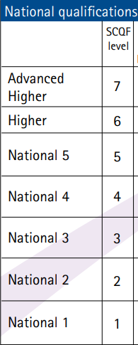
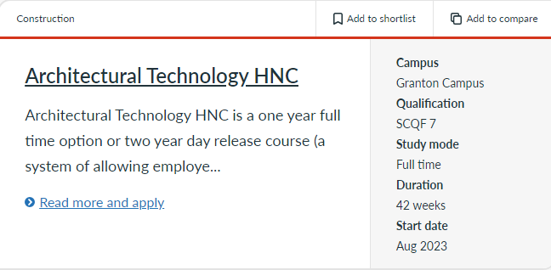

Slide 31
College
Applications normally open in January, and no closing date HOWEVER courses can fill quickly.
All applications to Edinburgh College require a personal statement of equal length to UCAS, so we advise our S6 to complete theirs at the same time as University pupils.
Can dual-track UCAS and College Applications.
Apply to a single course at a time.

Slide 32
HNC / HND
Common route into University
Higher National Certificate – 1 year course
Higher National Diploma – 2 year course
Can access year 2 or 3 of University following.

Slide 33
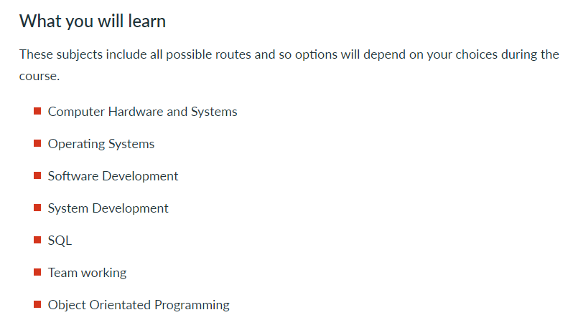

Slide 35
We support students who are traditionally under-represented in higher education.

Slide 36
Who we are…
LEAPS is a partnership organisation

Slide 37
What we do…
Provide impartial information, advice and guidance for students looking at going on to Higher Education – a HNC, HND or degree level course
Signpost to different services
Organise and run events and activities to support:
choices
application
transition into higher education
Offer individualised support to those fulfilling particular eligibility criteria
Notes:
Our events and activities include:
Online Course Checker (S5)
Parent and Carers Information Event (S5)
1:1 Interviews (S6)
LEAPS Transitions Course (S6)

Slide 38
What we do…
Our events and activities include:
Online course checker (S5)
Parent and carers information event (S5)
1:1 interviews (S6)
LEAPS Transitions Course (S6)
Results day helpline (S5 & S6)
Blog with lots of information and opportunities (S5 & S6, available for all!)

Slide 39
LEAPS eligibility criteria
In Group 2 schools, we support students who have the potential to achieve a minimum of 3 Highers by the time they finish school and match one or more of the following criteria:
student who is first generation in family to apply to higher education or whose parents do not already have a degree.
student from a low income background (for instance where a student is entitled to EMA, free meals in school, or where the family is entitled to a benefit such as Universal Credit).
student who has spent time in care or being looked after
student who is estranged
student who is a young carer
students may also be eligible based on their postcode (SIMD 20).
Notes:
Explain eligibility.
If you think you are LEAPS eligible, please let your guidance teacher know so that your name can be added to our list. Your teacher will share how they will gather your eligibility.
Remember, if you are not eligible, that there is lots of support available in your school to help you with this process.

Slide 40
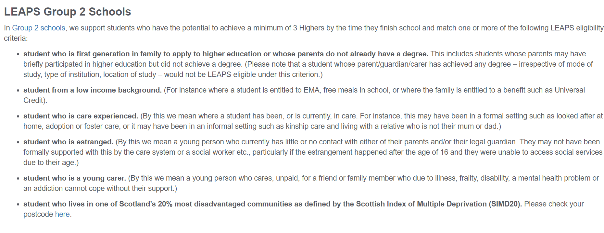
Postcode checker
Notes:
Highlight postcode checker on website. Always worth checking!

Slide 41
1:1 interview
Notes:
Moving into S6, if you are LEAPS eligible, you will then benefit from a 1:1 interview up where you can chat through your plans for university or college, and ask any questions you might have. Key points:
Explain purpose of interview is to discuss your application to college or university, including potential course choices, experience and achievements to date, and the personal statement. This will also be where we confirm LEAPS eligibility, so it is vital not to miss it if you don’t want to miss out on some of the benefits this can bring. Acknowledge that this can involve minimum or contextual offers but that this is at the discretion of universities and not something LEAPS has direct control over.
Interviews will take place in school sometime between late August and early November. Your guidance teacher will be able to tell you when your interview has been scheduled, after the summer early in S6.
If - at this stage - anyone is anticipating making an early application (e.g. to Oxbridge, Vet, Med), we will offer you an early interview to ensure we speak to you before the 15th October deadline. Get in touch with LEAPS direct, or via your guidance teacher to arrange this.
After your interview, you are welcome to reach back out to us with any questions you have and we’ll be happy to help. This doesn’t only cover whilst you’re still at school, but will also extend to S6 exam results day too…

Slide 42
LEAPS Transitions Course | Get the academic edge for university
This course is an S6 timetable option for LEAPS-eligible students.
Develop key first-year university-level academic skills to help you move from school to university!
Sessions take place online and on a university campus in Edinburgh.
www.leapsonline.org/transitions-course
Notes:
Explain the Transitions Course. Key points:
S6 timetable option for LEAPS-eligible students, designed to equip you with the skills and experience needed to make a positive transition from school to university.
Touch on timings – one timetable option, classes on Tuesday and Thursday afternoons, from September – Easter (over S6).
Also cover format - some sessions are online and some are on campus meaning some travel to Edinburgh is required – travel costs covered by LEAPS. How often students come on to campus will depend on where they live / travel time involved, but everyone will have some sessions on the university campus.
Key aims – developing first first-year university-level academic skills needed for college and university e.g. critical thinking, referencing, and independent learning, through attending lectures, tutorials and working with a postgraduate tutor. The qualification is worth 20 SCQF credit points at level 7 (same as year 1 of uni). Teachers might like to know it is also on Insight.
Other benefits include getting a student card for the University of Edinburgh, access to the university campus facilities and student discounts. Some universities also have an admissions agreement with LEAPS meaning they will take the course into account when you apply.
If interested, look out for info as you get closer to selecting your classes and subjects for S6.

Slide 43
Getting started…
Notes:
Blog posts! Talk through the S5 Hub. Key points:
The first thing to do is really just start your research! The blog posts on our S5 Hub are really helpful for this and cover everything from the routes that are available into Higher Education, but also the differences between college and university, how to make the most of open days and more!
Remind everyone again that these resources are available regardless of eligibility.
Keep in mind that ideally, everyone will have done some research before making subject choices for S6. When you’re making these choices, the information you have found should inform your decisions. To help with the process, LEAPS eligible students will be able to make use of the course checker tool…

Slide 44
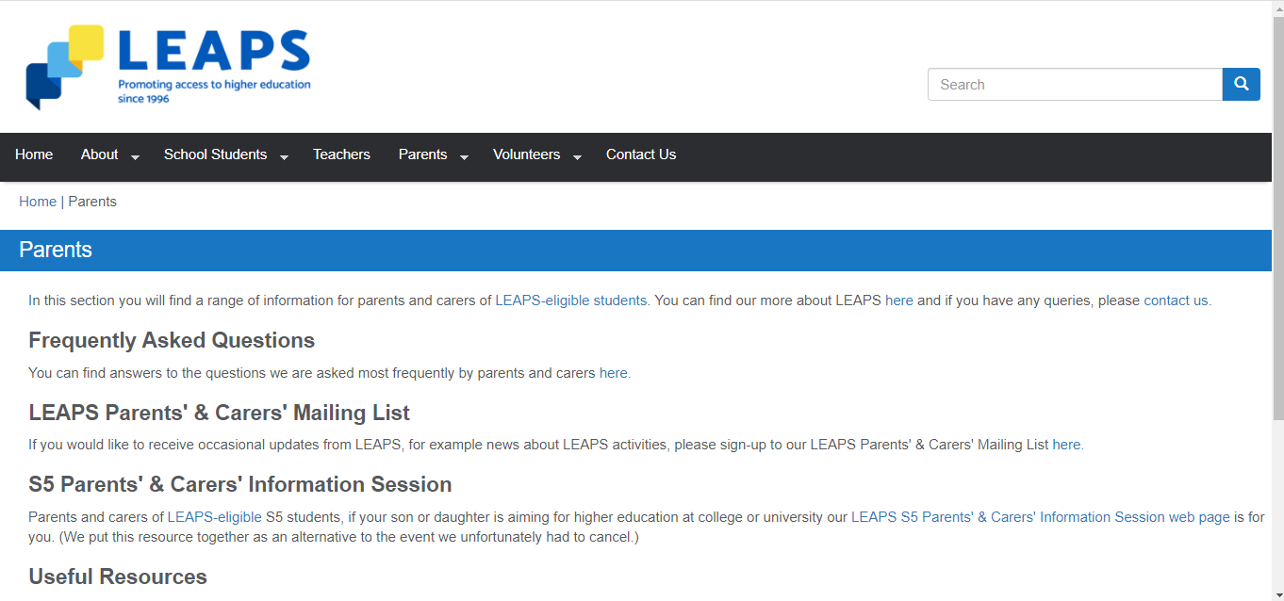
For parents and carers…
www.leapsonline.org/parents

Slide 46
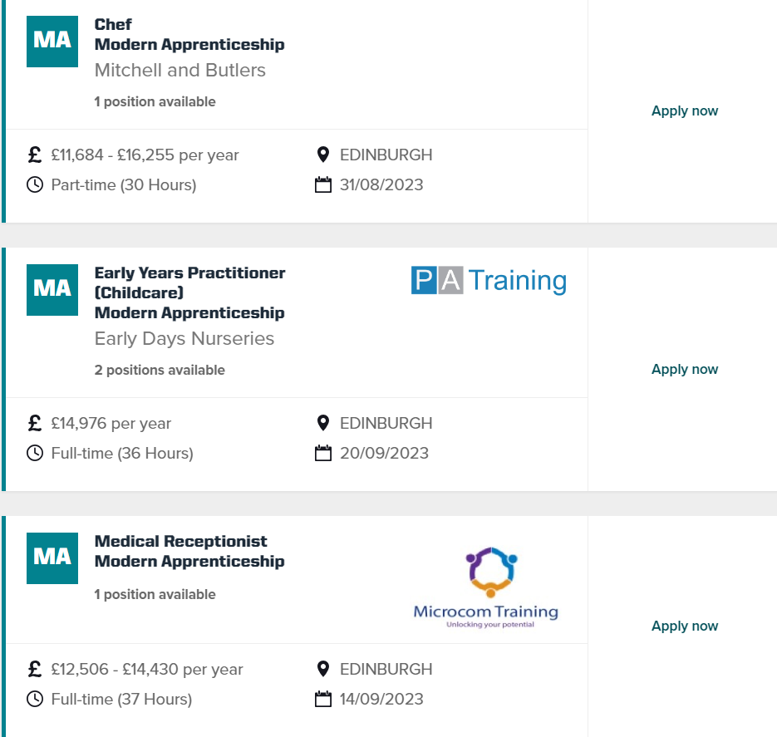

Slide 47
Apprenticeships -
Wide ranging and varied – from ‘traditional’ to new.
‘Earn and Learn’
Wide range of qualification requirements and salaries.
Can be very competitive – often a multi-stage interview process.
‘Rolling’, so pupils need to check website often. Not on a college / university timeline.

Slide 48
Next Steps
UCAS Discovery Event – Thursday 5th September – information to follow.
Pupils receiving personal statement lessons in PSE – ongoing
Your child – to be researching their options!
SDS support – Paula and Megan, Careers Advisors, based in school.

