Slide 1
Firrhill High School Sports Information Evening 2022

Slide 2
Evening
6.00 – 6.05pm Welcome
6.05 – 6.15pm Firrhill Sports Clubs
6.15 – 6.25pm School Sports Information
6.25 – 6.40pm Sports Tour 2024 Launch
6.40 – 6.45pm Colours Awards
6.45 – 7.45pm Sports Marketplace and Tasters

Slide 3
Extra-Curricular Clubs
A range of clubs are offered after school
Pupils should go to PE department straight after school to get changed
Pupils should wear PE kit and bring water
Most clubs finish at 4.45-5pm

Slide 4
Monday | Badminton 3.45-4.45 Mr Leitch Games hall | Cheerleading/ Tumbling Club 3.45-4.45 Miss Kupisz Gym | S1-3 Fitness 12.25-1pm Mrs Polwart Fitness Room | S4-6 Yoga 3.45-4.45 Miss Graham Dance Studio | S3 Hockey 4.30-6 Parents Oxgangs Astro
Tuesday | S1-3 Basketball 3.45-4.45 Mr Walkinshaw Games Hall | Athletics 3.45-4.45 Sed Remally Astro |  | S1-2 Rugby 4-5.15pm Boroughmuir rugby club, Meggetland | Senior Hockey 4.30-6 Parents Oxgangs Astro
Wednesday | Senior Basketball 3.45-4.45 Mr Monaghan Games hall | Girls Football 3.45-4.45 Miss Carmichael Astro | S1-3 Cricket 3.45-4.45 Miss Gray-Renfrew Astro | S3+ Rugby 4-5.15pm Boroughmuir rugby Club, Meggetland | Tennis 4-5 Shannon O’Brien Thistle tennis club
Thursday | S1-3 Netball 3.45-5.30 Miss Neilson Games Hall | Netball 3.45-5.30 Miss Neilson Gym |  | S1-3 Recreational Football 3.45-4.45 Braidburn Astro Mr Rahimian | S1 & 2 Hockey 4-5.30 Parents Main & Oxgangs Astro
Friday | Senior Football Training/Matches Mr Rahimian Main Astro
Saturday | Hockey training/matches Parents Oxgangs Astro

Slide 5
S1 Sporting activities
Mondays – badminton, cheerleading, fitness (lunchtime),
Tuesdays – basketball, athletics, rugby
Wednesdays – girls football, cricket, tennis
Thursdays – netball, recreational football, hockey
Saturdays – hockey and football fixtures

Slide 6
S1 Sporting activities
Please note:
Tennis takes place at Thistle Tennis Club
Rugby takes place at Meggetland

Slide 7
Sports Membership
All pupils attending extra-curricular clubs should have a ‘Sports Membership’.
Membership is paid through:
www.joininedinburgh.org Code: FIR-73
Cost is £24 for the year (free for pupils on free school meal entitlement)
Members get a Sports Membership T-Shirt

Slide 8
Athlete Support Programme
A programme of support for pupils who participate in sport at a high level.
The aim is to help pupils maintain a balance between their sporting commitments and their school commitments in order for them to reach their potential in both.
If you feel that your son/daughter is in this category please contact me:
morag.carmichael@firrhill.edin.sch.uk

Slide 9
Ethos
It is vital that respect is always shown to:
The rules
Our opponents
Officials
Team mates
Ourselves

Slide 10
Ethos
We are extremely proud of our sporting success.
Every pupil, parent or coach who is involved with sport at Firrhill is expected to represent the school in an extremely positive and sporting manner.

Slide 11
Ethos
We expect nothing but the highest standard of behaviour from the pupils of Firrhill.
The expectations placed upon pupils when in school are exactly the same as those placed upon them when competing for the school.

Slide 12
Communication
You can find out about sport at Firrhill through:
School website
Weekly bulletin
PE notice boards
PE twitter account (@FirrhillPE)
PE Instagram account (firrhillpe)
PE teachers and Miss Norman

Slide 13
Firrhill Sports Tour 2024
For current S2/3 pupils
Dates: Last week of term 2

Slide 14
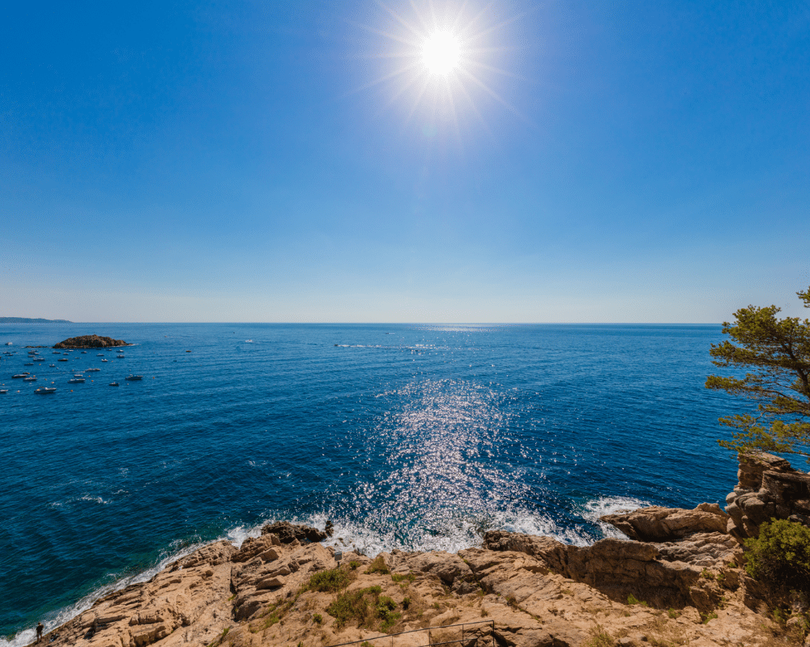
Sports Trip 2024

Slide 15
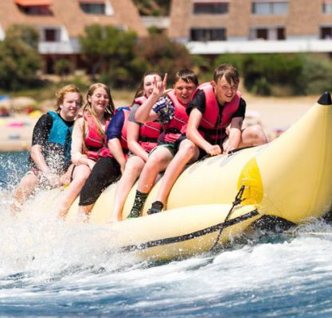
Sample Activity Programme
Day 1 – Depart and Overnight Travel (coach + ferry)
Day 2 – Arrive/Tour/Swim/Relax
Day 3- Banana Boats/Snorkeling
Day 4- WaterWorld and Target Sports
Day 5- Kayaking and Standup Paddleboarding
Day 6- Barcelona Visit (Camp Nou Tour- TBC) and High Ropes
Day 7- Choice of beach activities
Day 8 – Swim and Depart
Day 9 – Travel and return home

Slide 16
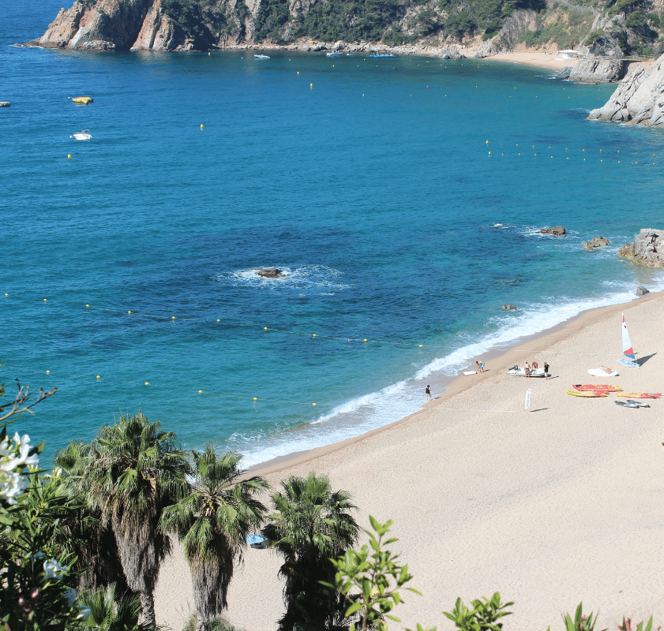
Key Info
Approximately £999 per person
Scope to run a fundraising group for pupils who are willing to give up their time
This is an inclusive tour for any current S2 or S3 pupils – you don't have to be part of a team
Full board accommodation + En-suite cabins
Prime location – within walking distance of the beach
Evening entertainment

Slide 18
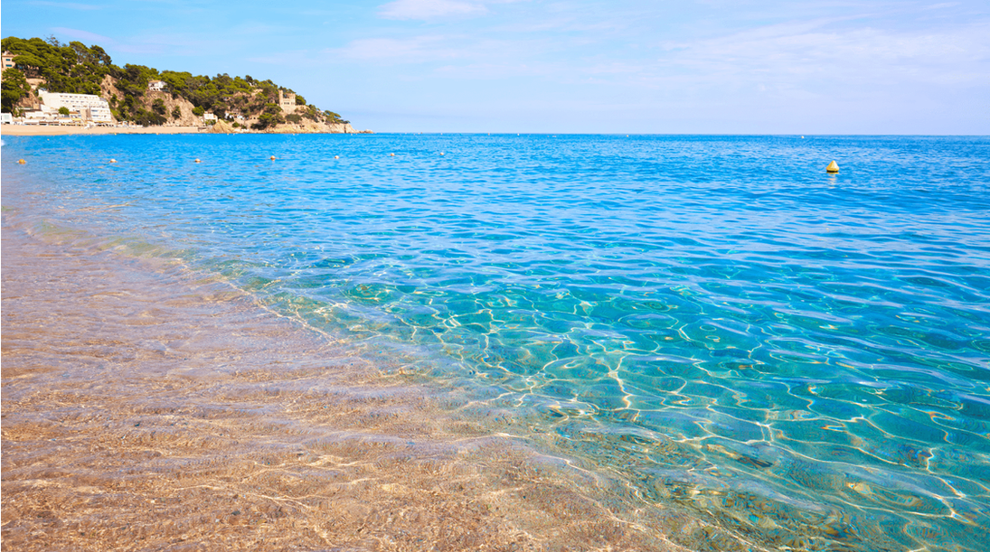
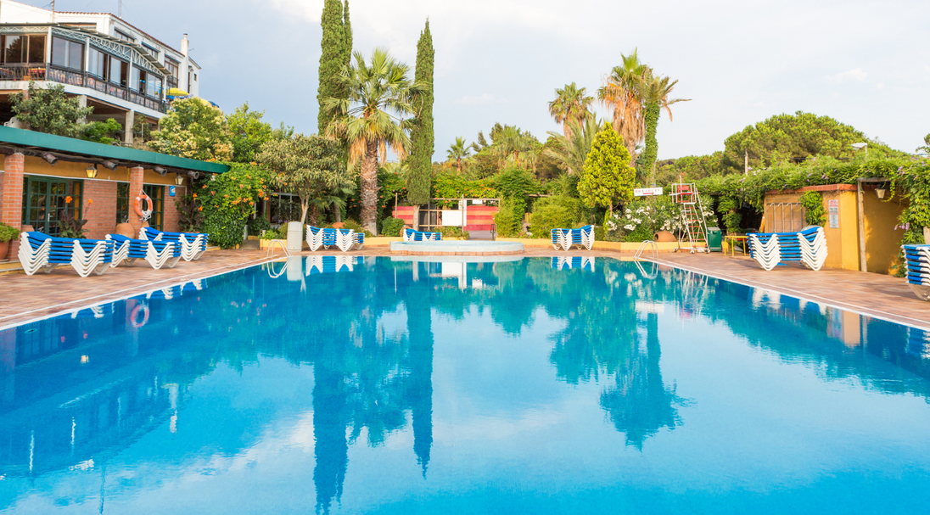
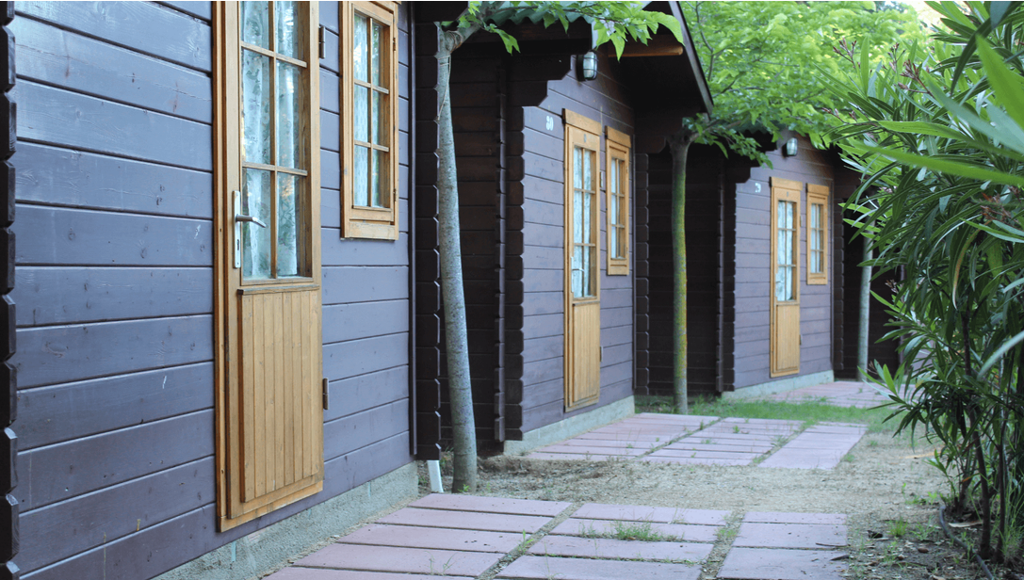

Slide 19
2024 Sports Trip
If interested in going on Sports Tour 2024 you must register your interest. Instructions on how to do this will be issued to parents/carers next week.
*Please note that the trip will not go live on Parent Pay until the council approve overseas trips.

Slide 20
Colours Awards

Slide 21
What are Colours?
Colours are a prestigious award which is traditionally awarded by schools to recognise excellence. At Firrhill we are using them to recognise excellence within 2 areas:
Endeavour
Representational
Colours are traditionally indicated by the wearing of a special tie or blazer. At Firrhill we will be awarding a badge (of the appropriate colour) which can be worn on the school tie.

Slide 22
Colour Award

Slide 23
Endeavour Colours
Awarded for:
Kindness
Resilience
Effort
Citizenship
Leadership

Slide 24
Representational Colours
These will be awarded at 4 different levels:
1 star - School
2 star - Regional
3 star – National
4 star - International
Each faculty has created criteria for representation.

Slide 25
Colour Awards
Information will follow later in the school year regarding the nomination process but parents/carers, pupils and staff can all nominate for these awards.

Slide 26
Club Promotion
Marketplace:
City of Edinburgh basketball club, Colinton Panthers (American football), George Watsons Community Sports Hub, Forth Canoe Club, Firrhill Hockey Club, Colinton Castle Squash Club, Kingsknowe Golf Club, Holyrood netball club
Tasters:
Assembly Hall - cheerleading
Main astro: golf
Games Hall: squash and netball

Slide 27
Thanks for listening!

Slide 28
Sportscotland Gold Sports Award

