Slide 1
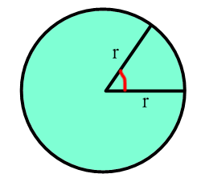
Circular Motion
Radian Measure
A Radian is the size of the angle of a sector when the arc length is equal to the radius.
arc length = radius
1 radian
360 degrees = 2π radians
180 degrees = π radians

Slide 2
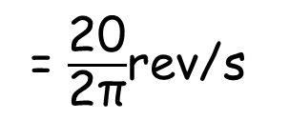
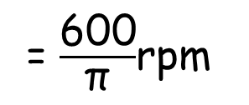
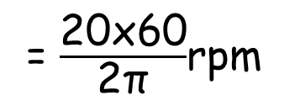
Radian Conversions
To convert between revolutions and radians we use the knowledge that 1 rev = 2π radians.
1) Convert 6000 revs/min into rad/s
6000 rpm
= 6000 x 2π rad/min
= $\frac{\text{6000 }\text{x}\text{ 2}\text{π}}{\text{60}}$rad/s
Page 221
Exercise 12A
Q1 - 5
= 200π rad/s
2) Convert 20 rad/s into revs/min
= $\frac{\text{20}}{\text{2}\text{π}}$rev/s
20 rad/s
= $\frac{\text{20}\text{x}\text{60}}{\text{2}\text{π}}$rpm
= $\frac{\text{600}}{\text{π}}$rpm

Slide 3
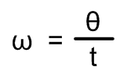
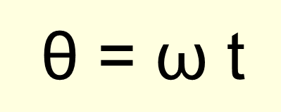
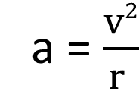
Angular velocity
Angular velocity usually denoted by
ω (greek letter omega)
and is measured in rad/s.
Angular velocity in terms of angle Ɵ
Angular velocity in terms of linear velocity
ω = $\frac{v (linear velocity)}{r (radius)}$
Acceleration in terms of linear velocity
a = $\frac{v2}{r }$

Slide 4
Angular velocity in terms of linear velocity
B
A particle is travelling from A to B on the circumference of a circle with radius r and linear speed v ms⁻¹.
Q
v
ω
A
P
If the time taken to travel from A to B is 1 second then
Arc AB = v x 1 = v metres
If the angular velocity is ω rad/s then
Arc AB = $\frac{ω}{\text{2}\text{π}}$ x $\text{2}\text{π}$r
=> v = $ω$r
Arc AB = $ω$r
or ω = $\frac{v}{r}$

Slide 5
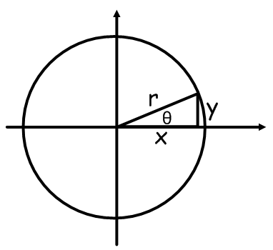
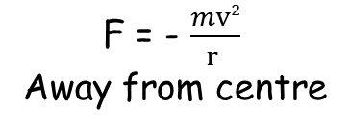
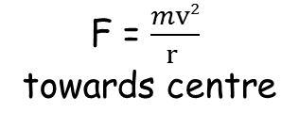
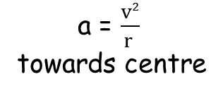
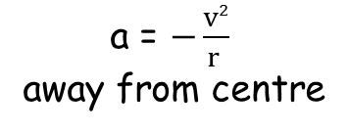
Acceleration in terms of linear velocity
In vector form
r = xi + yj (away from centre)
x = r cos θ
y = r sin θ
x = r cos ωt
i
y = r sin ωt
j
v_{x} = $\frac{dx}{dt}$
v_{y} = $\frac{dy}{dt}$
j
i
v_{x} = -r ω sin ωt
i
v_{y} = r ω cos ωt
j
a_{x} = $\frac{d2x}{dt2}$
a_{y} = $\frac{d2y}{dt2}$
F = -mω² r
i
j
a = -ω² r
i
a_{y} = -r ω² sin ωt
j
As ω = $\frac{v}{r}$
a = -($\frac{v}{r}$)² r
a_{x} = -r ω² cos ωt
a_{x} = -ω²x
i
a_{y} = -ω²y
j
a = -$\frac{v2}{r2}$ r
a = $−\frac{v2}{r }$
away from centre
a = $\frac{v2}{r }$
towards centre
a = a_{x} + a_{y} = (-ω²x) i + (-ω²y) j
a = -ω² (x i + y j )
F = - $\frac{mv2}{r }$
Away from centre
F = $\frac{mv2}{r }$
towards centre

Slide 6
Page 221
Exercise 12A
Q6 – 11
Page 226
Exercise 12B
Q1, 2, 6, 10

Slide 7
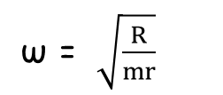
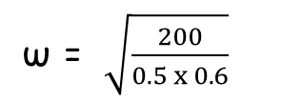
Centripetal Force
Centripetal Force is the force towards the centre.
Centrifugal Force is the force away from the centre.
Example 1.
A 500g mass on a 60cm string is rotated in a horizontal circle by a machine. The string has a breaking strain of 200N.
What is the maximum rpm that the machine can do without the string breaking?
F_{c} = mω² r
= R
F_{c}
R
ω² = $\frac{R}{mr}$
ω = $\sqrt{\frac{R}{mr}}$
0.5kg
ω = $\sqrt{\frac{200}{0.5 x 0.6}}$
ω = 25.8 rad/s
ω = $\frac{\text{25.8}}{\text{2}\text{π}}$ x 60
ω = 247 rpm

Slide 8
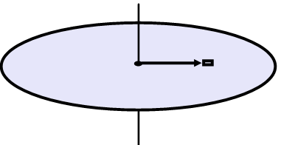
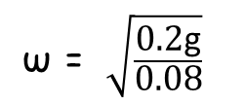
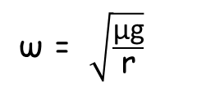
Example 2.
A small 50g mass lies on a horizontal rotating disc, 8cm from the centre. The coefficient of friction between the disc and the mass is 0.2
The speed of rotation slowly increases.
At what angular velocity does the mass start to slide?
F_{r} = μR
F_{c} = mω² r
In equilibrium F_{c} = F_{r}
mω² r = μR
ω² = $\frac{\text{μ}\text{mg} }{\text{m} \text{r}}$
R
F_{c}
ω² = $\frac{\text{μ}\text{g} }{\text{r}}$
F_{r}
0.05kg
ω = $\sqrt{\frac{\text{μ}\text{g}}{\text{r}}}$
mg
ω = $\sqrt{\frac{\text{0.2}\text{g}}{\text{0.08}}}$
ω = $4.95 rad/s$

Slide 9
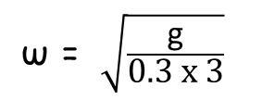
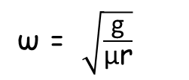
Example 3.
In a fairground "wall of death" innocent victims are spun in giant "washing machine" with vertical axis of rotation. If the friction coefficient between clothes and wall is 0.3, the radius of the machine is 3 metres, find the minimum angular velocity when they will seem to stick to the wall.
F_{r} = μR
F_{c} = mω² r
= R
F_{r} = μmω² r
= mg
ω² = $\frac{\text{mg} }{\text{μ}\text{mr}}$
ω² = $\frac{\text{g} }{\text{μ}\text{r}}$
F_{r}
ω = $\sqrt{\frac{\text{g}}{\text{μ}\text{r}}}$
F_{c}
R
ω = $\sqrt{\frac{\text{g}}{\text{0.3 }\text{x}\text{ 3}}}$
mg
ω = 3.3 rad/s

Slide 10
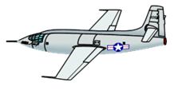
Example 4.
A plane of mass 5000kg has wings which provide enough lift to support its weight when flying at 200ms-1. The plane then turns by banking at an angle of 30⁰ to horizontal, and using the rudder on the tailfin.
(a) What is the lift force from the wings?
(b) What is the radius of the plane's turn?
(c) What else happens to the plane when the wings are banked?
L
(a)
L = mg
L = 5000 x 9.8
mg
L = 49000 N
F_{c} = $\frac{mv2}{r }$
= x_{L}
L
$\frac{mv2}{r }$= Lsin 30º
(b)
30º
F_{c}
r = $\frac{mv2}{\text{Lsin}\text{ 30}\text{o}}$
F_{c}
30º
r = $\frac{5000 x 2002}{\text{49000}\text{x}\text{sin}\text{ 30}\text{o}}$
mg
r = 8163m

Slide 11
L
(c)
30º
F_{c}
F_{c}
30º
mg
The vertical lift will alter:
y_{L} = Lcos30º
y_{L} = 49000 x cos30º
y_{L} = 42435N
As the vertical lift is now less than 49000N the plane will descend.

Slide 12
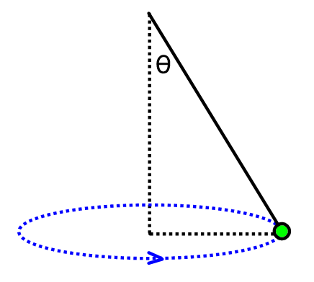
Conical Pendulums
Similar to back and forth pendulum, but goes round in a circle, string at angle to the vertical.
We can derive an equation for the angle in terms of g, ω and the length of string

Slide 13
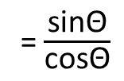
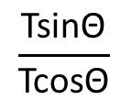
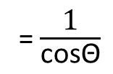
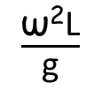
T
F_{c} = mω² r
= TsinΘ
TcosΘ
mg
= TcosΘ
TsinΘ
F_{c}
$$\frac{\text{Tsin}\text{Θ}}{\text{Tcos}\text{Θ}}$$
= $\frac{\text{m}\text{ω}\text{2 }\text{r}}{\text{mg}}$
= tanΘ
mg
tanΘ = $\frac{\text{ω}\text{2 }\text{r}}{\text{g}}$
If the length of the string is L
tanΘ = $\frac{\text{ω}\text{2}\text{Ls}\text{in}\text{Θ}}{\text{g}}$
= $\frac{\text{sin}\text{Θ}}{\text{cos}\text{Θ}}$
sinΘ = $\frac{\text{r}}{\text{L}}$
Θ
L
$\frac{\text{ω}\text{2}\text{L}}{\text{g}}$
= $\frac{\text{1}}{\text{cos}\text{Θ}}$
r = LsinΘ
cosΘ = $\frac{\text{g}}{\text{ω}\text{2}\text{L}}$
r

Slide 14
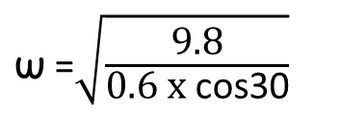
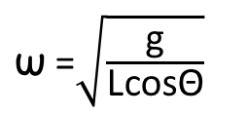
A string, length 60cm, has one end attached to a fixed point and it rotates at an angle of 30⁰ to the vertical. The other end is attached to a 50g mass.
What is the tension in the string and the angular velocity?
30⁰
mg
= TcosΘ
cosΘ = $\frac{\text{g}}{\text{ω}\text{2}\text{L}}$
0.6m
T = $\frac{mg}{cosθ}$
$\text{ω}\text{2}$ = $\frac{\text{g}}{\text{Lcos}\text{Θ}}$
T = $\frac{0.05 x 9.8}{cos30}$
$\text{ω}$ =$\sqrt{\frac{\text{g}}{\text{Lcos}\text{Θ}}}$
0.05g
T = 0.57N
$\text{ω}$ =$\sqrt{\frac{\text{9.8}}{\text{0.6 }\text{x} \text{cos}\text{30}}}$
$\text{ω}$ = 4.34 rad/s

Slide 15
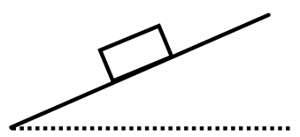
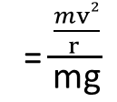
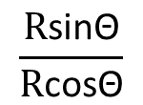
Circular Motion on Banked Curves
x_{R}
x_{R} = RsinΘ = F_{c}
F_{c} = $\frac{mv2}{r }$
y_{R} = RcosΘ = mg
R
y_{R}
$$\frac{\text{R}\text{sin}\text{Θ}}{\text{R}\text{cos}\text{Θ}}$$
= $\frac{\frac{mv2}{r }}{\text{mg}}$
= tanΘ
F_{c}
mg
tanΘ = $\frac{v2}{\text{r}\text{g}}$

Slide 16
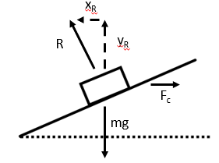
For maximum speed friction ($\text{μ}$R) works down the slope
F_{r} = μR
x + x_{R} = μRcos Θ + RsinΘ = F_{c}
= $\frac{mv2}{r }$
R(μcosΘ + sinΘ) = $\frac{mv2}{r }$
x
y_{R} - y = RcosΘ - μRsinΘ = mg
y
F_{r}
R(cosΘ – μsinΘ) = mg
$\frac{\text{R}\text{(}\text{μ}\text{cos}\text{Θ} \text{+ }\text{sin}\text{Θ}\text{)}}{\text{R}\text{(}\text{cos}\text{Θ}\text{ – }\text{μ}\text{sin}\text{Θ}\text{)}}$= $\frac{\frac{mv2}{r }}{mg }$
Divide equations
$\frac{\text{μ}\text{cos}\text{Θ} \text{+ }\text{sin}\text{Θ}}{\text{cos}\text{Θ}\text{ – }\text{μ}\text{sin}\text{Θ}}$= $\frac{v2}{rg }$
Divide top and bottom by $\text{cos}\text{Θ}$
$\frac{\text{μ} \text{+ }\text{ta}\text{n}\text{Θ}}{\text{1}\text{ – }\text{μ}\text{tan}\text{Θ}}$= $\frac{v2}{rg }$
$v2$ = rg($\frac{\text{μ} \text{+ }\text{ta}\text{n}\text{Θ}}{\text{1}\text{ – }\text{μ}\text{tan}\text{Θ}} )$
$v$ = $\sqrt{\text{rg}\text{(}\frac{\text{μ} \text{+ }\text{tan}\text{Θ}}{\text{1}\text{ – }\text{μ}\text{tan}\text{Θ}} ) }$

Slide 17
A car is going round a bend with a radius of 70m with a banked angle of 20º. There is a friction coefficient of 0.3. Find the highest and lowest speeds that will prevent the car slipping.
For maximum speed friction ($\text{μ}$R) works down the slope
RsinΘ
Horizontally
Rsin20 = F_{c} - 0.3Rcos20
F_{c} = $\frac{mv2}{70 }$
R(0.3cosΘ20+ sin20) = $\frac{mv2}{70 }$
R
RcosΘ
$\text{μ}$RcosΘ
Vertically
Rcos20 = mg + 0.3Rsin20
$\text{μ}$RsinΘ
F_{c}
R(cos20 – 0.3sin20) = mg
Θ
$\text{μ}$R
mg
$\frac{\text{R}\text{(0.3}\text{cos}\text{20} \text{+ }\text{sin}\text{20}\text{)}}{\text{R}\text{(}\text{cos}\text{20}\text{ – }\text{0.3}\text{sin}\text{Θ}\text{20}}$= $\frac{\frac{mv2}{70}}{mg }$
$\frac{\text{0.3}\text{cos}\text{20} \text{+ }\text{sin}\text{20}}{\text{cos}\text{20}\text{ – }\text{0.3}\text{sin}\text{20}}$= $\frac{v2}{70g }$
$$v2 = 70g (\frac{\text{0.3}\text{cos}\text{20} \text{+ }\text{sin}\text{20}}{\text{cos}\text{20 – 0.3}\text{sin}\text{20}} )$$
$$v2 =511.314…$$
$$v =22.6m/s$$

Slide 18
For minimum speed friction ($\text{μ}$R) works up the slope
RsinΘ
Horizontally
F_{c} = Rsin20 - 0.3Rcos20
F_{c} = $\frac{mv2}{70 }$
R(sin20- 0.3cos20) = $\frac{mv2}{70 }$
RcosΘ
R
$\text{μ}$R
$\text{μ}$RsinΘ
Vertically
Rcos20 + 0.3Rsin20 = mg
F_{c}
$\text{μ}$RcosΘ
R(cos20 + 0.3sin20) = mg
Θ
mg
$\frac{\text{R}\text{(}\text{sin}\text{20− 0.3}\text{cos}\text{20)}}{\text{R}\text{(}\text{cos}\text{20} \text{+} \text{0.3}\text{sin}\text{Θ}\text{20}}$= $\frac{\frac{mv2}{70}}{mg }$
$\frac{\text{sin}\text{20− 0.3}\text{cos}\text{20}}{\text{cos}\text{20} \text{+} \text{0.3}\text{sin}\text{20}}$= $\frac{v2}{70g }$
$$v2 = 70g (\frac{\text{sin}\text{20− 0.3}\text{cos}\text{20}}{\text{cos}\text{20 + 0.3}\text{sin}\text{20}} )$$
$$v2=39.56…$$
$$v =6.29 m/s$$

Slide 19
Vertical Circular Motion
A particle with circular motion moving in a vertical plane will have a varying velocity due to the effects of gravity i.e. as the particle increases in height it’s velocity will decrease.
V ms⁻¹
To consider questions of this nature one method is to look at the Potential and Kenetic Energies at the different points of the circle.
Kenetic Energy is found by using KE = $\frac{1}{2}$mv²
Potential Energy is found by using PE = mgh
The sum of PE and KE is the same at all points

Slide 20
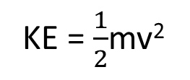
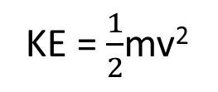
Vertical Circular Motion – Finding the Velocity
A particle of mass 12kg is suspended from a fixed point by a light string of 3m. The initial horizontal speed is 8ms⁻¹. What is the speed of P when the centre angle is 40º?
O
40º
3m
B
v ms⁻¹
O
x = cos40 x 3
A
3m
x
40º
x = 2.298…
8 ms⁻¹
B
12kg
h = 3 - 2.298…
At Point A
At Point B
h
h = 0.702m
KE = $\frac{1}{2}$mv²
KE = $\frac{1}{2}$mv²
A
KE = $\frac{1}{2}$x 12 x 8²
KE = 6v²
6v² + 82.54 = 384
PE = mgh
6v² = 301.46
KE = 384 J
PE = 12 x g x 0.702
v² = 50.24
PE = 0 J
PE = 82.54 J
v = 7.09ms⁻¹

Slide 21

Vertical Circular Motion – Finding the Tension
A particle of mass 12kg is suspended from a fixed point by a light string of 3m. The initial horizontal speed is 8ms⁻¹. What is the tension at point B?
O
T
40º
3m
B
7.09 ms⁻¹
A
8 ms⁻¹
12kg
Applying F = ma
O
T
= $\frac{mv2}{r }$
T – mgcos40 = F_{c}
B
T = 12gcos40 + $\frac{12 x 7.092}{3 }$
mg
mgcos40
40º
T = 291.06 N

Slide 22
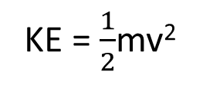
Vertical Circular Motion – Finding the Angle
A particle of mass 9kg is suspended from a fixed point by a light string of 4m. It is projected from point A with an initial horizontal speed of 3.2ms⁻¹. The particle reaches point B and then returns to point A and oscillates.
What is the size of the angle?
O
Θ
4m
B
A
0 ms⁻¹
3.2 ms⁻¹
9kg
O
At Point A
At Point B
4m
Θ
KE = $\frac{1}{2}$mv²
KE = 0 J as v = 0ms⁻¹
4-h
B
KE = $\frac{1}{2}$ x 9 x 3.2²
PE = 46.08 J
= mgh
cosΘ = $\frac{4−\frac{128}{245}}{4}$
h
h = $\frac{46.08}{9g}$
A
KE = 46.08 J
Θ = 29.6º
PE = 0 J
h = $\frac{128}{245}$m

